Slide 1


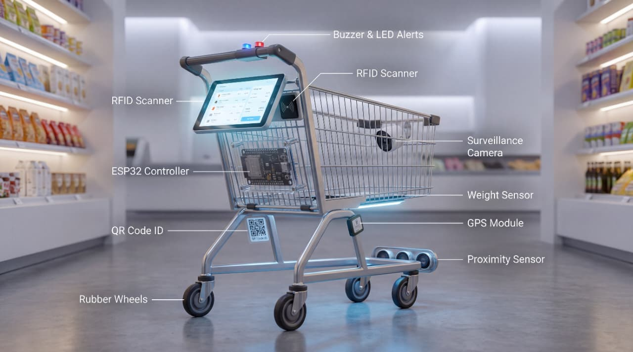
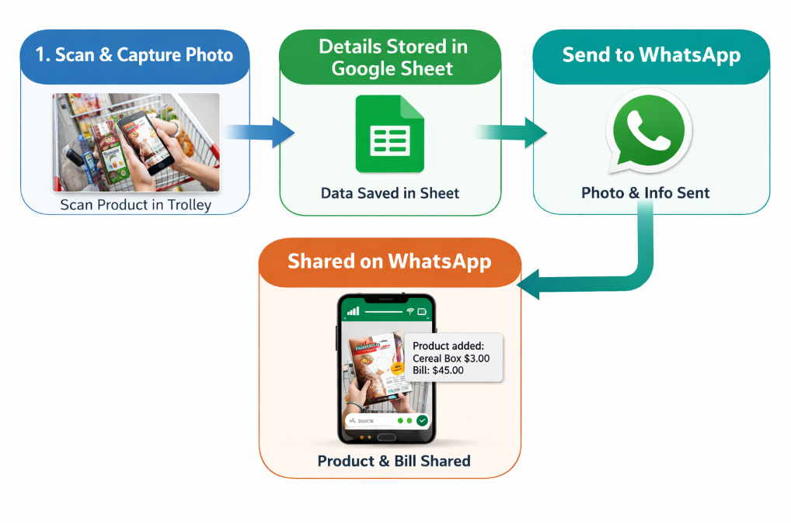

Rungta College Of Engineering & Technology
Bhilai (C.G), India
Automated Smart Shopping Trolley with Real-Time WhatsApp Billing System
“Survival isn’t luck, it’s discipline”
Introduction
Datasets Information
Methodology
Automated Billing System: The smart trolley uses RFID to automatically detect products and calculate the bill in real time, removing the need for manual checkout.
Live Display & Notifications: LCD shows selected items and price instantly, while WhatsApp integration sends real-time billing updates to the user.
Efficient Data Management: All transactions are stored in Google Sheets, ensuring easy tracking, transparency, and future analysis of purchases.
Product Dataset Structure – Contains RFID tag ID, product name, and price mapped in a structured format for quick identification during scanning.
Real-Time Transaction Data – Stores each scan event with item details, timestamp, and total bill updates for accurate purchase tracking.
Cloud-Based Record Storage – All dataset entries are logged in Google Sheets for easy access, monitoring, and future analysis of shopping behavior.
Data Collection
Database & Storage
RFID Processing & Hardware Control
Billing & Communication System
User Interface Module
System Output
Workflow
Figure : Methodology
Fig: Smart Trolley System Overview
Objective
To make shopping automated using smart-trolley
To scan products in real time
To calculate and display bill instantly
To reduce billing queue time
To send alerts using cloud
To reduce human errors and improve efficiency
Problem Statement
Future work
Results
Add AI-based product recognition to improve scanning accuracy.
Integrate automatic payment system using UPI or card payment.
Develop a mobile app for users to track their shopping in real time.
Improve system speed for faster scanning and bill generation.
Add inventory management for store owners to track stock automatically.
The system scans products and stores details automatically in Google Sheet with accuracy. It generates the final bill and sends it to the user via WhatsApp instantly.
Figure : People in queue in marts/Malls
Feature | Description
Real-time Product Scanning: | The system scans each product instantly using a scanner and records the details automatically,
Automatic Data Storage: | All scanned product information is saved in a Google Sheet for easy tracking and management.
Instant Bill Generation: | The system calculates the total amount and generates the bill automatically after scanning.
WhatsApp Notification: | Customers receive product details and final bill directly on WhatsApp in real time.
User-Friendly System: | Simple interface that can be easily used by customers without technical knowledge.
Faster Checkout Process: | Reduces waiting time in queues and makes shopping quick and smooth.
Error Reduction: | Minimizes human errors in billing and data entry by automating the entire process.
Website for References
Google Sheets API Documentation: https://developers.google.com/sheets/api
Twilio WhatsApp API Documentation: https://www.twilio.com/docs/whatsapp
Details
Name: Debashish Mishra
Position: Student of Dr. kalam batch
Email: debashishmishra888@gmail.com
Rungta Educational Campus, Kohka-Kurud Road, Bhilai - 490024, Chhattisgarh, India
https://rungta.ac.in/

